Slide 1
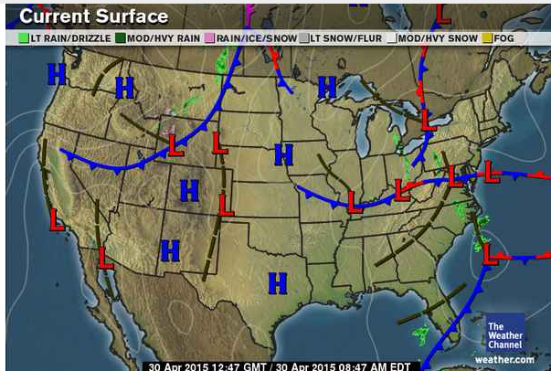
Current Conditions:
Temp: 44F
Humidity: 89%
Wind: NW 7 mph
Pressure: 29.88 in
Weather: Light Rain

Slide 2
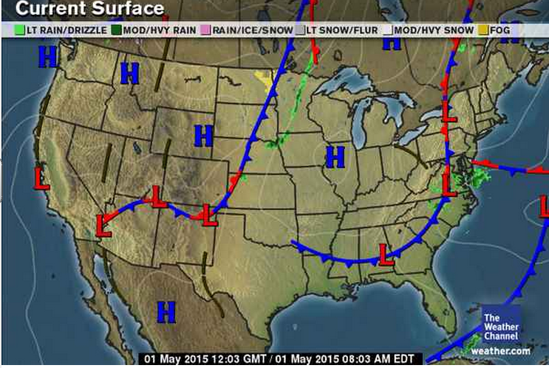
Current Conditions:
Temp: 47F
Humidity: 81%
Wind: NW 6 mph
Pressure: 30.06 in
Weather: Clear and sunny
Note: Please get your current event ready to discuss!

Slide 3
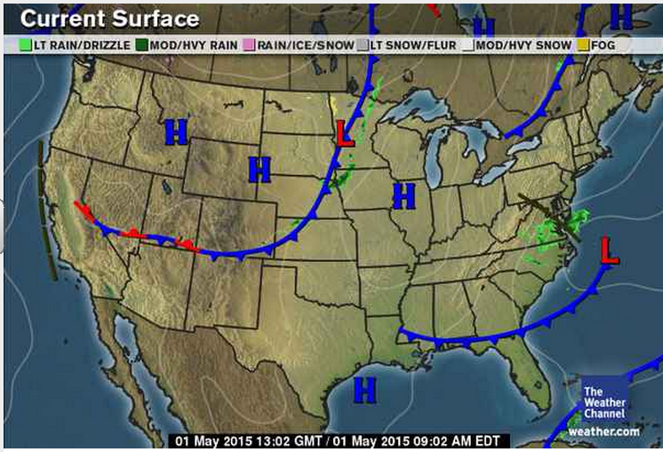
Saturday’s Conditions:
Temp: 49F
Humidity: 64%
Wind: WNW 2 mph
Pressure: 30.11 in
Weather: Clear and sunny

Slide 4
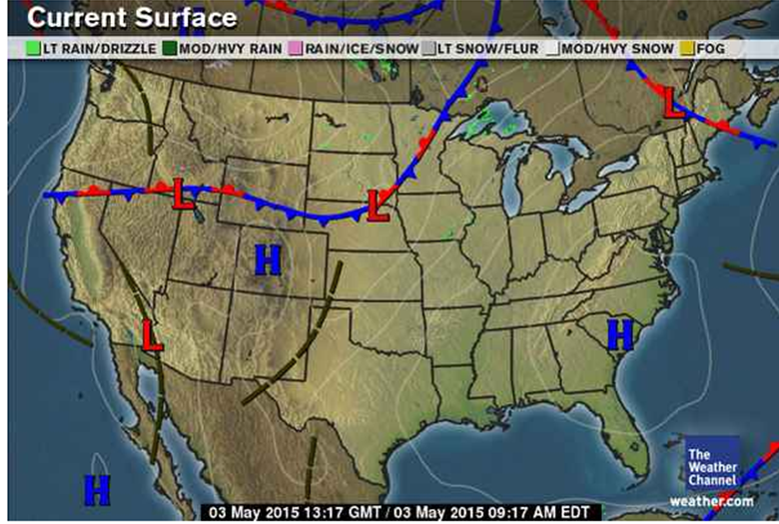
Sunday’s Conditions:
Temp: 55F
Humidity: 41%
Wind: WSW 12 mph
Pressure: 30.07 in
Weather: Mostly sunny

Slide 5
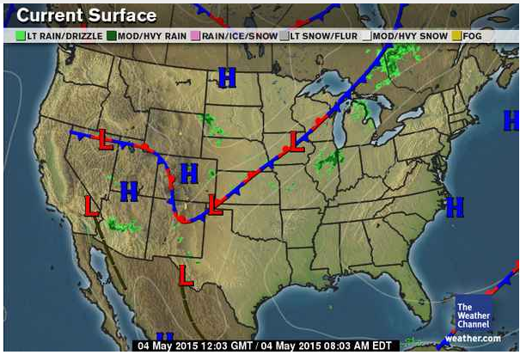
Current Conditions:
Temp: 63F
Humidity: 68%
Wind: SW 7 mph
Pressure: 30.04 in
Weather: Mostly cloudy

Slide 6
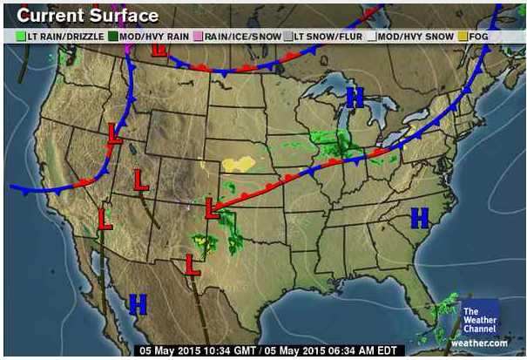
Current Conditions:
Temp: 51F
Humidity: 55%
Wind: NE 8 mph
Pressure: 30.30 in
Weather: Cloudy

