Slide 1
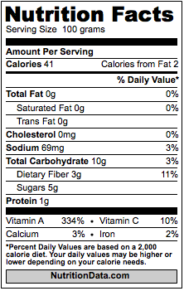
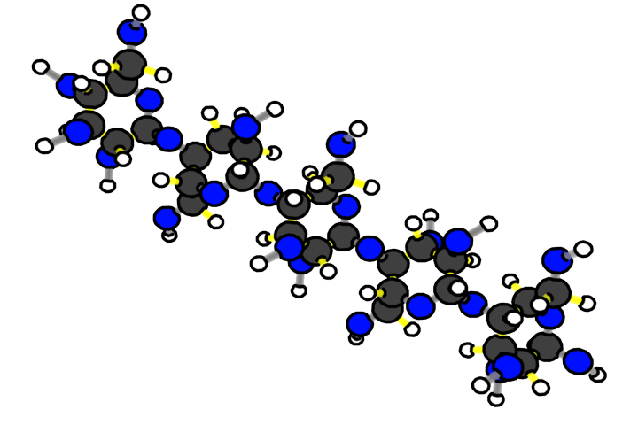
Activity 2.2:
Molecules Cells Are Made Of

Slide 2
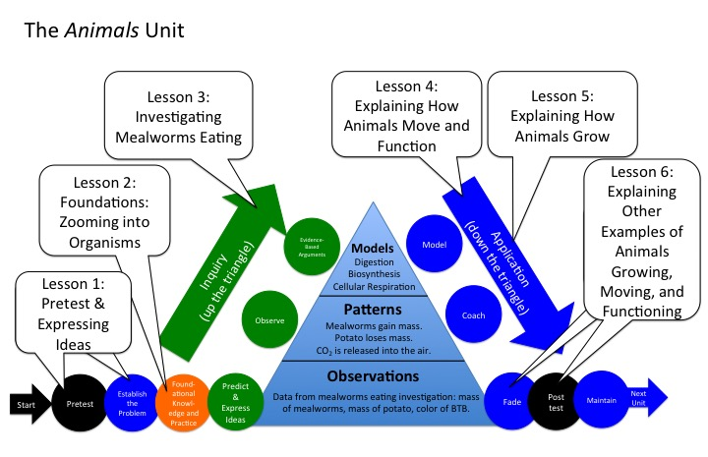
Unit Map
You are here
Notes:
Use the instructional model to show students where they are in the course of the unit.
Show slide 2 of the 2.2 Molecules Cells Are Made Of PPT.

Slide 3
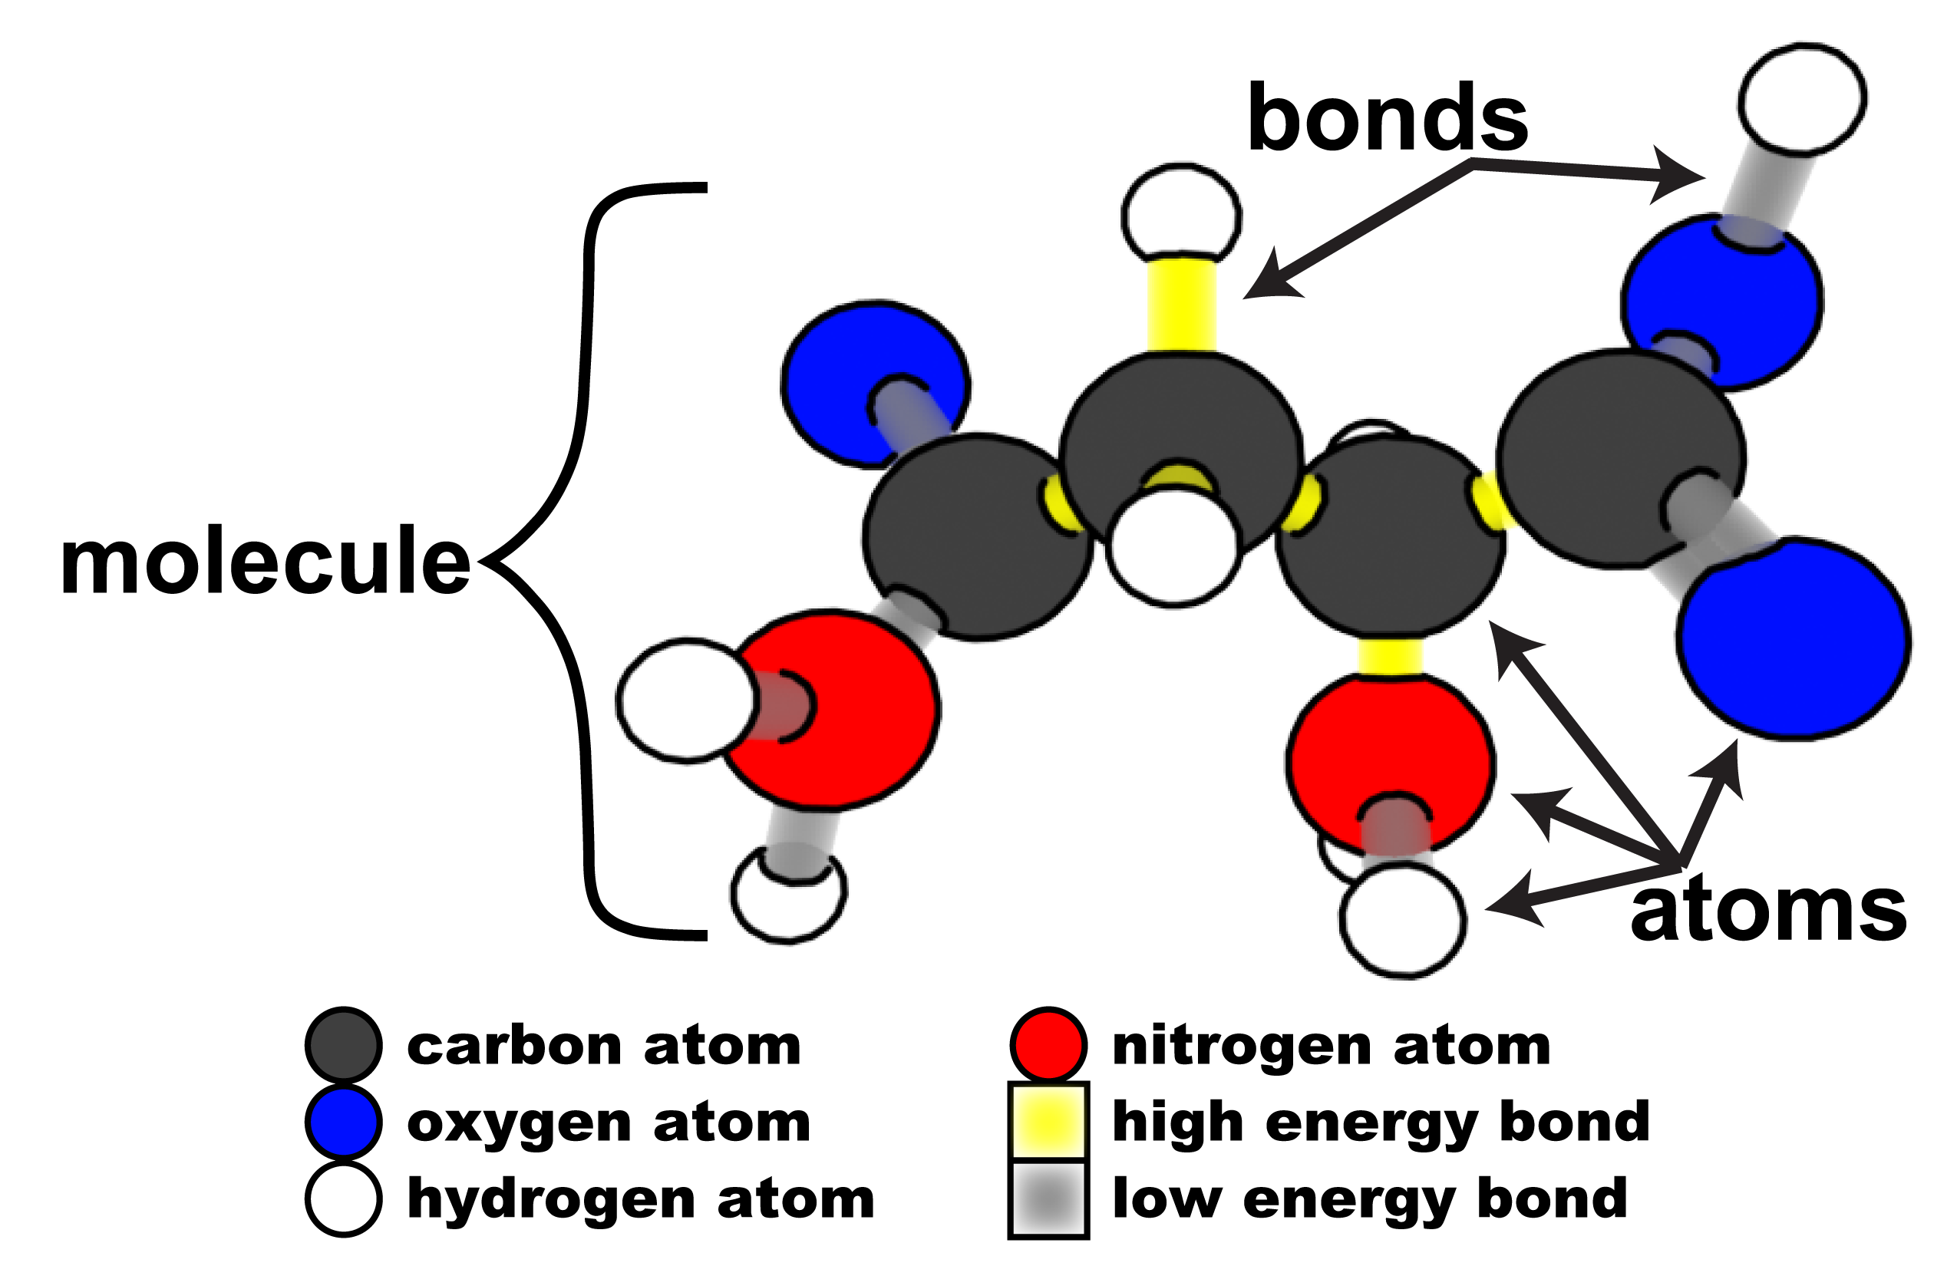
Notes:
Review how atoms bond together to make molecules/
Show Slide 3 of 2.2 Molecules Cells Are Made of PPT and point to the copy of the Molecule 11 x 17 Poster on your classroom wall. Ask students to examine the key features of this poster:
Atoms are represented by differently colored circles. In the Carbon TIME units: carbon is black, oxygen is blue, nitrogen is red, and hydrogen is white.
Bonds that connect carbon to carbon and carbon to hydrogen bonds are colored yellow. This color represents the chemical energy stored in these bonds. Other types of bonds are not yellow because they do not contain as much stored chemical energy.
When two or more atoms bond together, this creates a molecule.
Credit: Craig Douglas, Michigan State University

Slide 4
Facts and questions about organisms
Some things we know:
Some unanswered questions
All organisms are made of cells
All the functions of organisms are done by cells working together
All cells are made of molecules
All molecules are made of atoms
What kinds of molecules are cells made of?
How do those molecules move and change when cells do their functions, such as:
  Growing
  Moving
  Changing matter and energy?
Notes:
Review ideas and unanswered questions from Activity 2.1.
Show Slide 4 of the PPT:
Review some things we know in the left column
Review unanswered questions in the right column
This activity focuses on the question in red: “What kinds of molecules are cells made of?”

Slide 5
What kinds of molecules are cells made of?
We can find out what materials cells are made of by reading nutrition labels for plants, animals, and decomposers that we eat.
We will use labels with a serving size of 100 g.
This means that
1 g = 1% of the materials in the food
Notes:
Present and discuss how to interpret nutrition labels
Have students follow on 2.2 Reading Nutrition Labels Handout as you present Slides 5-18 in the PPT. Each slide points toward parts of the nutrition labels that are also presented on the handout:
Slide 5 points out that (unlike nutrition labels on most foods) these labels use a standard serving size of 100g.

Slide 6
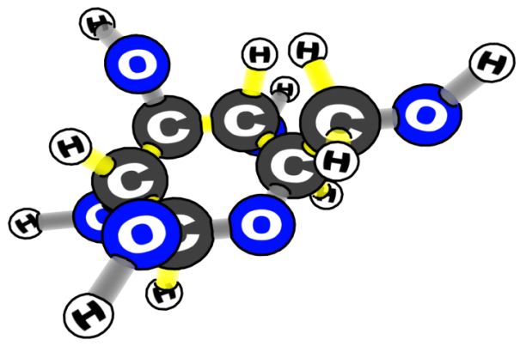
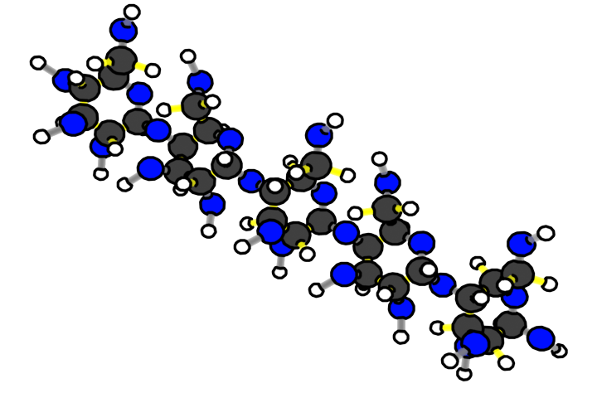
What are cells made of?
CARBOHYDRATES
fiber
glucose
What atoms are carbohydrates made of?
starch
Notes:
Slides 6 and 7 focus on carbohydrates, including how to calculate the amount of starch (total carbohydrate – sugar – fiber)

Slide 7
Carbohydrates in Carrots (Plant Root)
Total carbohydrate = starch + sugar + fiber (such as cellulose)
How much starch is in 100 grams of carrots?
Notes:
Slides 6 and 7 focus on carbohydrates, including how to calculate the amount of starch (total carbohydrate – sugar – fiber)

Slide 8
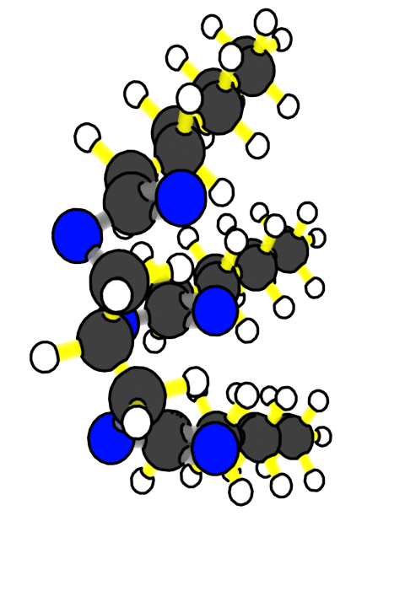
What are cells made of?
FATS
What atoms are fats made of?
1 glycerol
3 fatty acids
Fat molecule
Notes:
Slides 8 and 9 focus on fats, including the atoms in fat molecules (CHO)

Slide 9
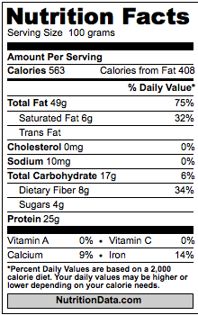
Fat in Peanuts (Plant Seeds)
How much fat is in 100 grams of peanuts?
Notes:
Slides 8 and 9 focus on fats, including the atoms in fat molecules (CHO)

Slide 10
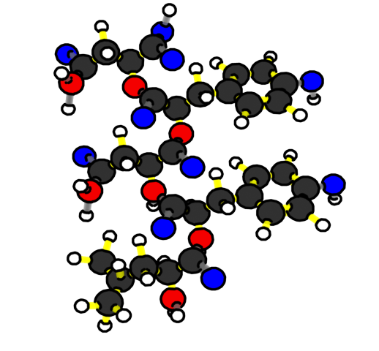
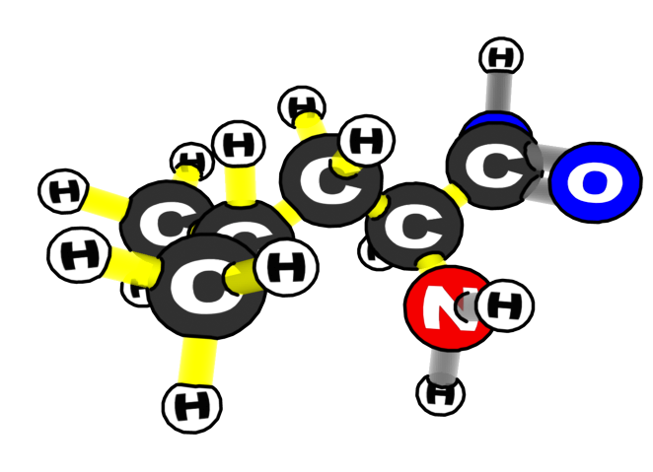
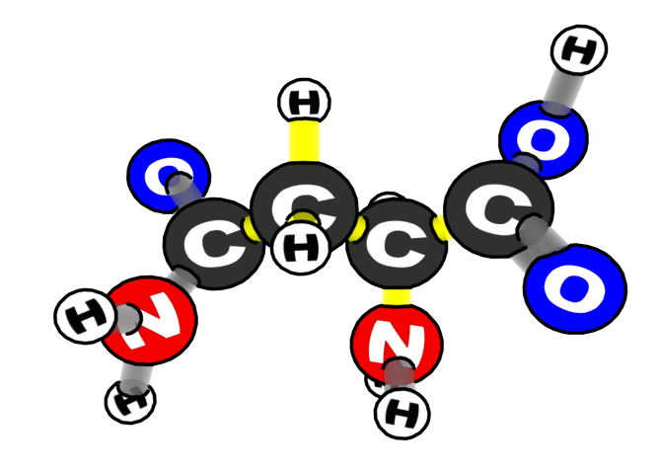
What are cells made of?
PROTEIN
Two of the Amino Acids
What atoms are proteins made of?
Notes:
Slides 10 and 11 focus on proteins, including the atoms in protein molecules (CHON)

Slide 11
Protein in Carrots (Plant Roots)
How much protein is in 100 grams of carrots?
Notes:
Slides 10 and 11 focus on proteins, including the atoms in protein molecules (CHON)

Slide 12


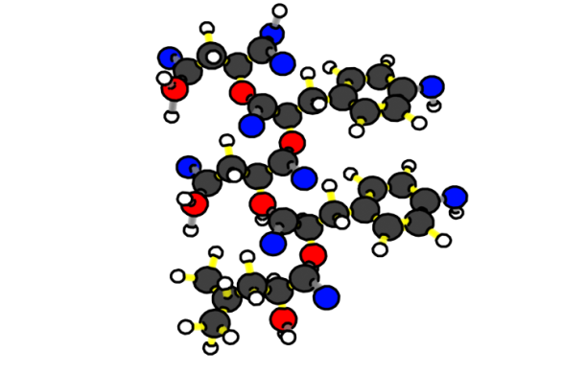
Organic Molecules in All Cells
CARBOHYDRATES:
GLUCOSE
FATS
STARCH
What atoms are organic molecules in plants made of?
PROTEINS
Notes:
Slide 12 points out that all the organic molecules in cells are made primarily of 4 kinds of atoms: CHON. (If you wish to discuss other atoms in organic molecules such as P and S, you could do so later with Slides 21 and 22.)

Slide 13
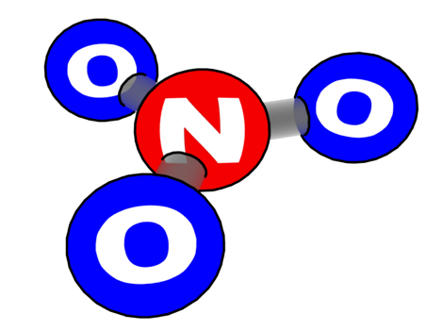


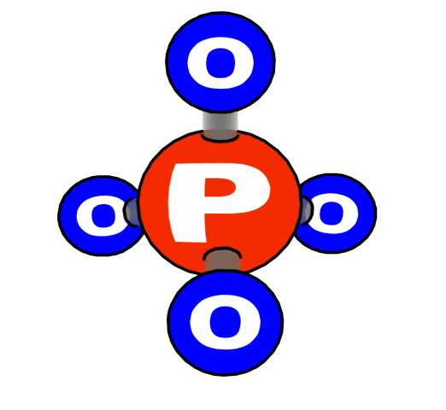
Minerals in Cells
Cells also contain minerals that are used
for cell functions. These minerals have different kinds of atoms, including:
Nitrogen
Phosphorous
Calcium
Sodium
Notes:
Slides 13 and 14 point to cholesterol, vitamins, and minerals: molecules found in cells but always less than 1% of cell mass.

Slide 14
Other Molecules in Cells
Vitamins, minerals, and cholesterol make up less than 1% of cell mass (less than 1 gram out of 100 grams).
Notes:
Slides 13 and 14 point to cholesterol, vitamins, and minerals: molecules found in cells but always less than 1% of cell mass.

Slide 15
Water in Cells
Besides organic materials or biomass (fats, proteins, and carbohydrates) cells are made up mostly of water.
About how much water is in 100 grams of carrots?
Notes:
Slides 15 and 16 focus on how to calculate the amount of water in cells by subtracting the total mass of organic matter from 100g.

Slide 16
Adding up materials in carrots (plant root cells)
Organic materials in carrots
Protein: 1% (1 g out of 100 g)
Carbohydrates: 10%
Fat: 0%
Cholesterol and vitamins: less than 1%
Inorganic materials in carrots
Minerals (sodium, iron): less than 1%
What’s left?
WATER: about 89%
Notes:
Slides 15 and 16 focus on how to calculate the amount of water in cells by subtracting the total mass of organic matter from 100g.

Slide 17
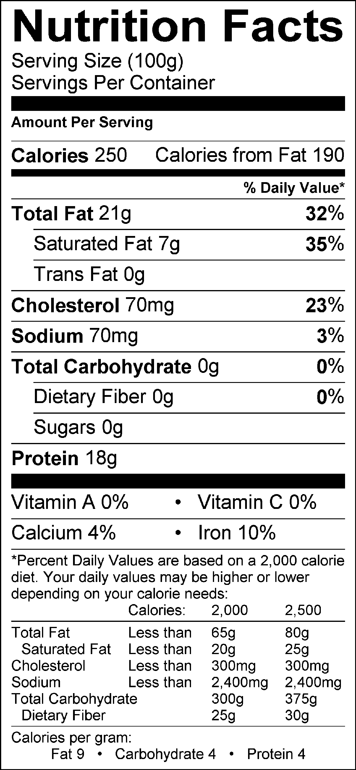
Adding up materials in beef (animal muscle cells)
Beef
Organic materials in beef:
Fat: 21% (21 g out of 100 g)
Carbohydrates: 0%
Protein: 18%
Cholesterol and vitamins: less than 1%
Inorganic materials in beef:
Minerals (calcium, sodium, iron): less than 1%
What’s left?
WATER: about 60%
Notes:
Slides 17 and 18 connect information about calories on food labels with what students have already studied about chemical energy in organic molecules in the Systems and Scale unit. Note that high-energy C-C and C-H bonds are yellow on the illustrations of molecules.

Slide 18
Chemical energy in cells
Beef
Calories are a measurement of chemical energy in cells and food: the energy available from high-energy bonds in organic molecules
High-energy C-C and C-H bonds are yellow. This color represents the usable energy stored in these bonds.
Notes:
Slides 17 and 18 connect information about calories on food labels with what students have already studied about chemical energy in organic molecules in the Systems and Scale unit. Note that high-energy C-C and C-H bonds are yellow on the illustrations of molecules.

Slide 19

Which molecules have chemical energy?
CARBOHYDRATES:
GLUCOSE
STARCH
FATS
MINERALS
WATER
PROTEINS
Notes:
Have students work together to complete the worksheet.
Now that students are somewhat familiar with the molecules in food, have them explore the makeup of other foods. Divide students into pairs to complete 2.2 Food Labels Worksheet.
Show Slide 19 on the PPT.
Have pairs of students work together to complete the first row of the worksheet for “beef.”

Slide 20
Try it yourself!
Use the food label cards to fill in the table showing the materials in different kinds of cells on the 2.2 Food Labels worksheet.
What patterns do you notice when you compare a food made of animal cells (beef) with foods made of plant cells (carrots, celery, spinach)? Explain the patterns you found on the worksheet.
Notes:
Show Slide 20. Check to make sure that all pairs successfully completed the first row.
Discuss the last question on the worksheet: How are plant and animal cells different? Students should note that plant cells tend to have more carbohydrates and water and less fat and protein than animal cells (with seeds such as peanuts being the exception).

Slide 21
Cells are really complicated!
Large organic molecules are really larger than our pictures:
  Fats: 50-100 carbon atoms (+ H and O)
  Proteins: hundreds of carbon atoms (+ H, N, and O)
  Starch: thousands of carbon atoms (+ H and O)
  Cellulose (fiber): thousands of carbon atoms (+ H and O)
There are also other large organic molecules, such as deoxyribonucleic acid (DNA)
Notes:
Discuss the complexity of all cells.
Use Slides 21 and 22 and the Metabolic Pathways Poster to point out that the “whole story” of cell structure and function is much more complicated than they can study in this class:
Slide 21 points out that large organic molecules—carbohydrates, fats, and proteins—are actually much larger than the molecules illustrated on the slides (too large for illustrations that would show all the atoms).

Slide 22
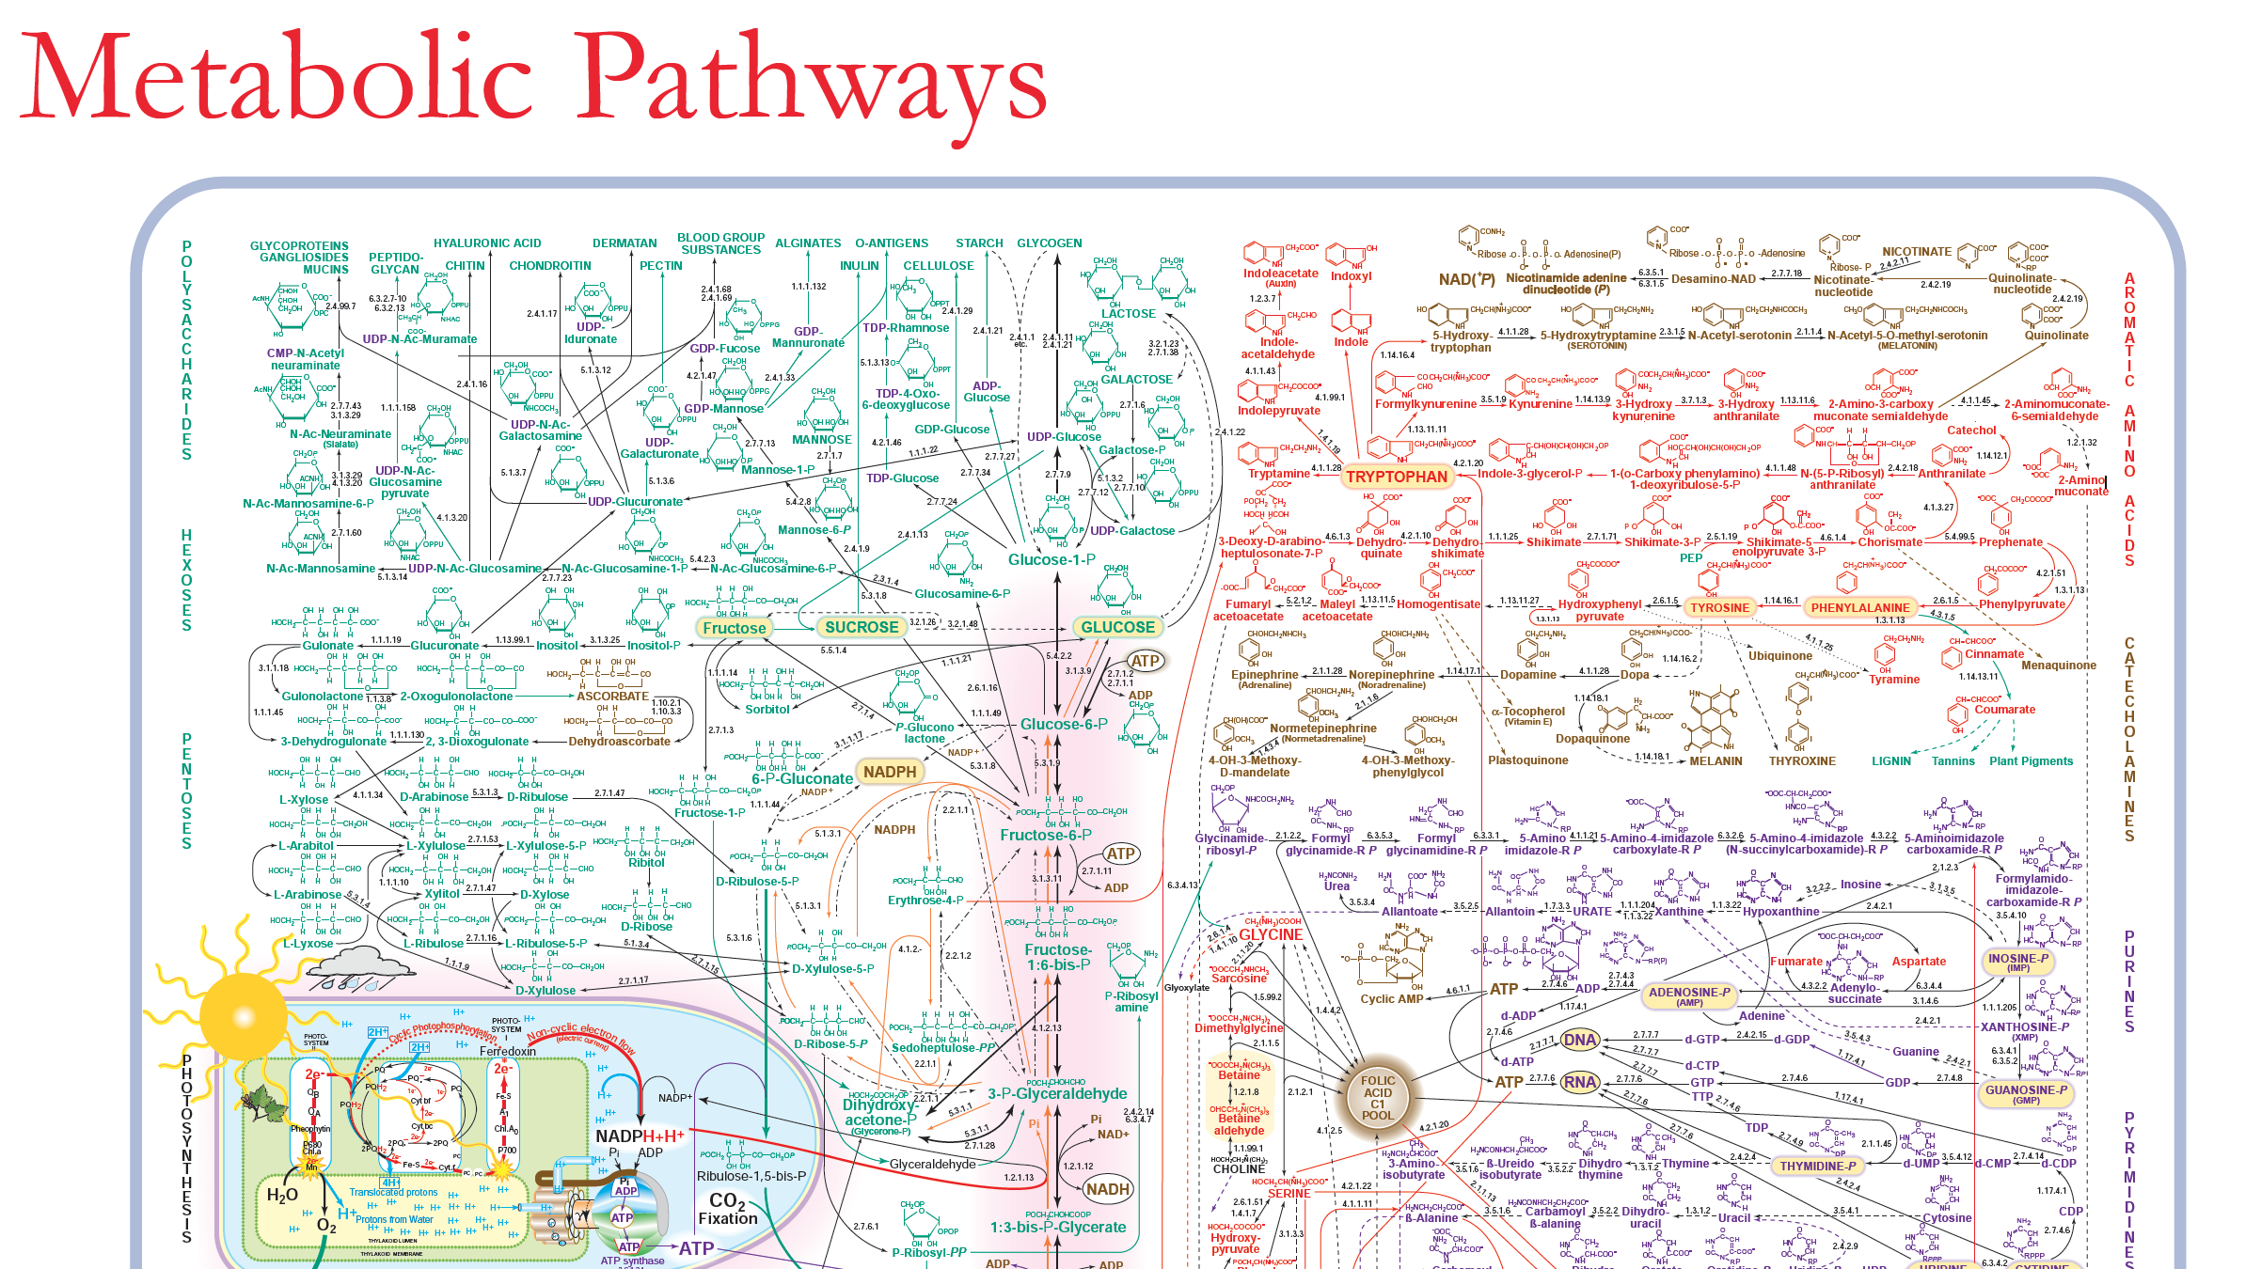
Cells are really complicated!
There are many more small organic molecules than the ones in this lesson. Look at the Metabolic Pathways poster to see some of them.
Notes:
Slide 22 points out that there are many more small organic molecules than the ones we have discussed, and that cells have many ways to change one kind of small organic molecule into another.
Show students the Metabolic Pathways Poster and invite them to look at it more closely when they have time. The poster is still “incomplete” in that it shows only pathways involving small organic molecules. When they study cellular processes such a cellular respiration and photosynthesis, students may enjoy locating them on the poster.

