Slide 1

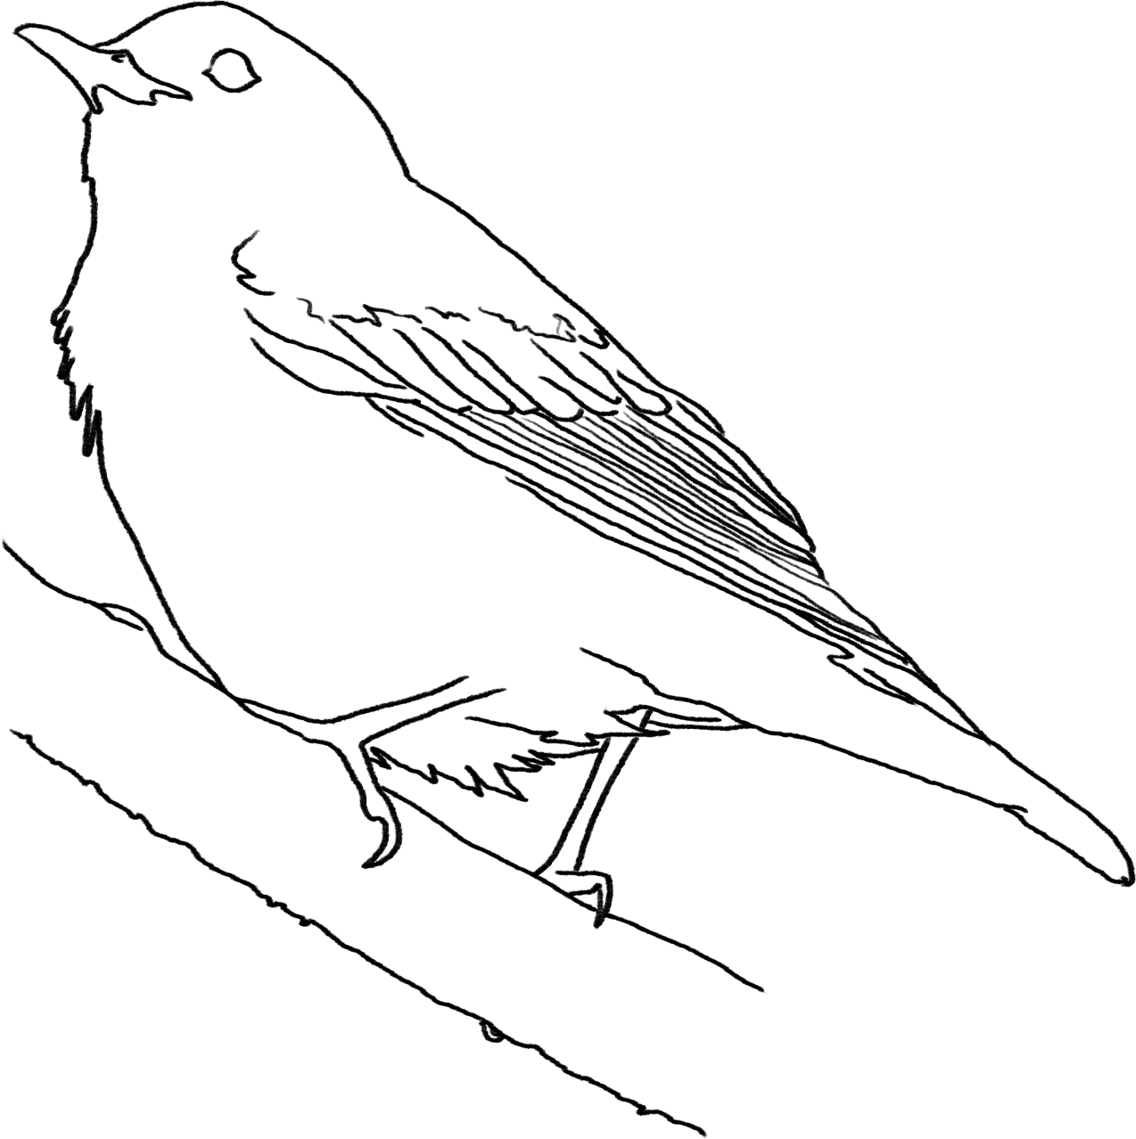
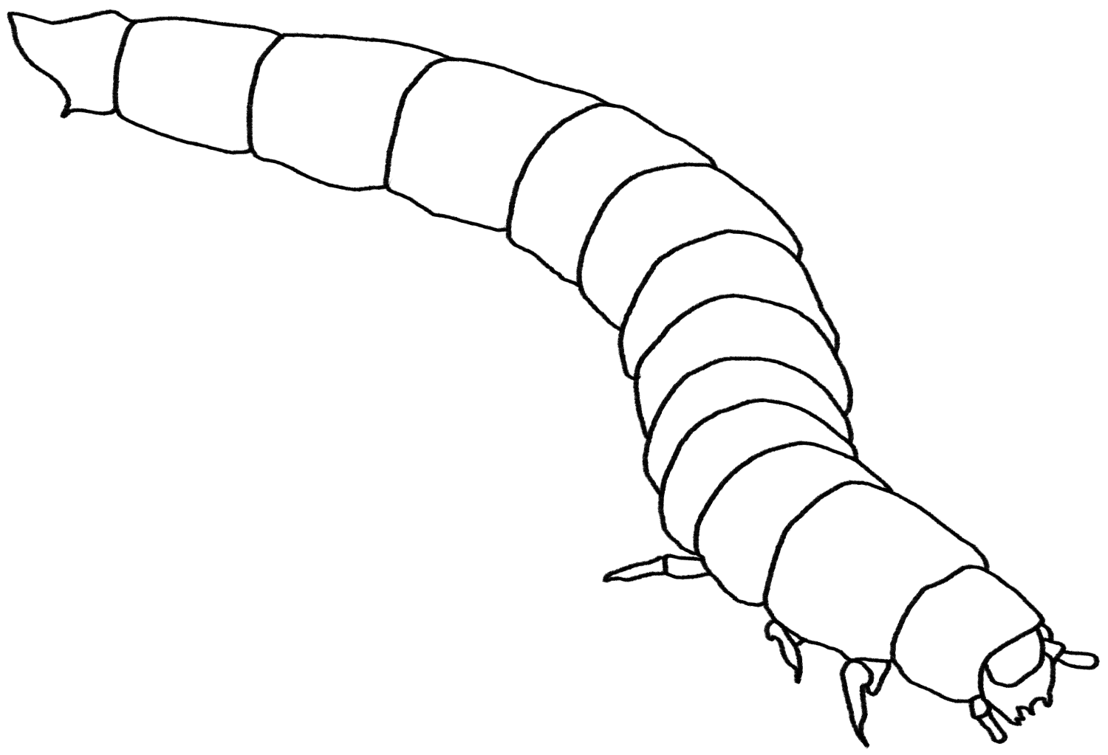
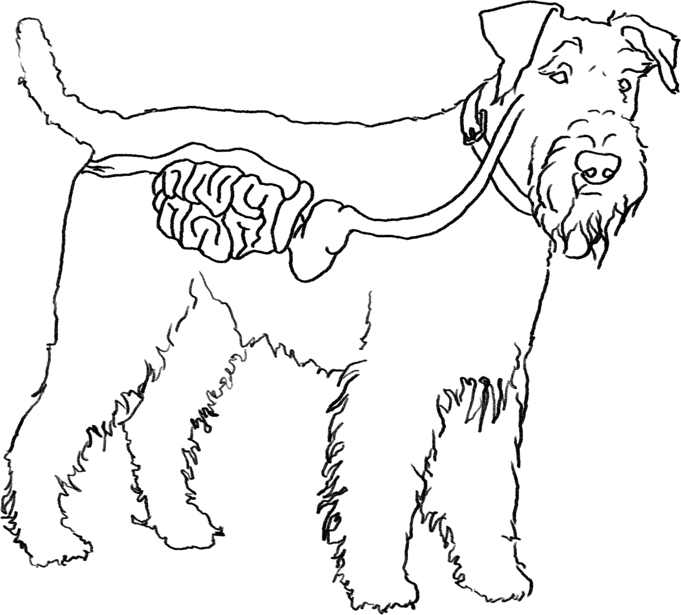
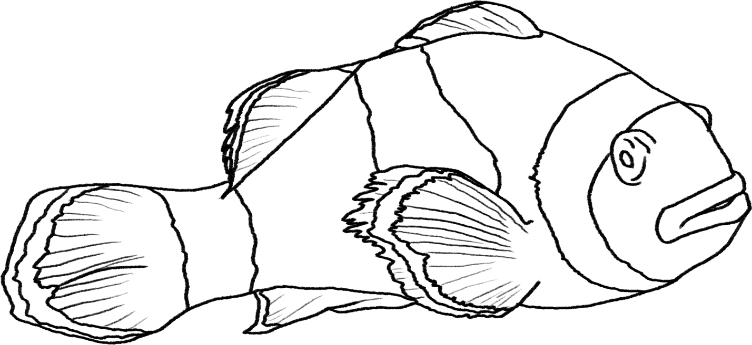
Animals Unit
Activity 6.1: Explaining Other Examples of Animals Growing and Moving
Carbon: Transformations in Matter and Energy
Environmental Literacy Project
Michigan State University
Notes:
Image Credit: Craig Douglas, Michigan State University

Slide 2
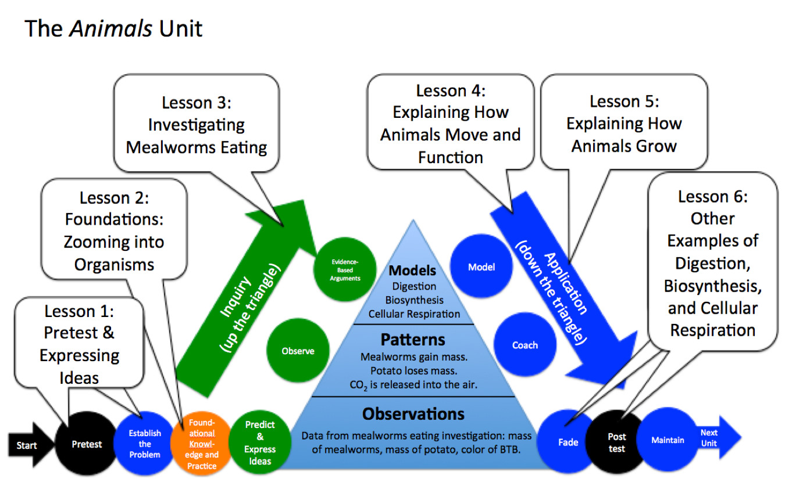
Unit map
You are here
Notes:
Use the instructional model to show students where they are in the course of the unit.
Display slide 2 of the 6.1 Explaining Other Examples of Animals Moving and Growing PPT.

Slide 3
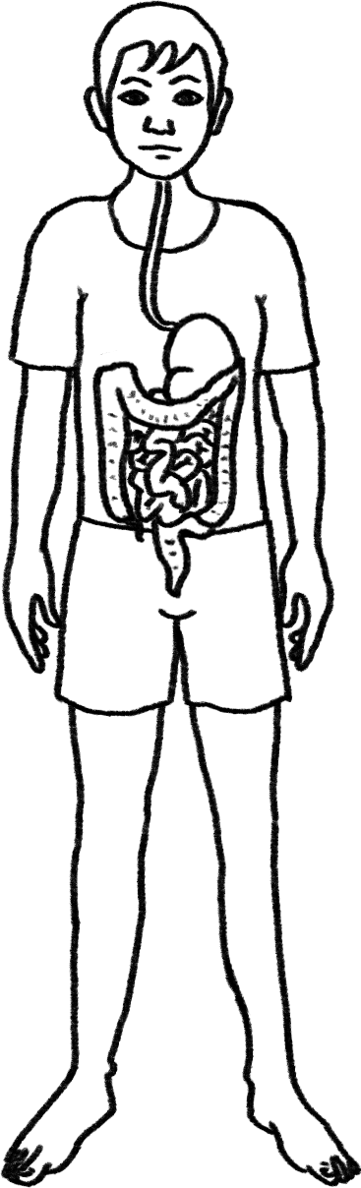
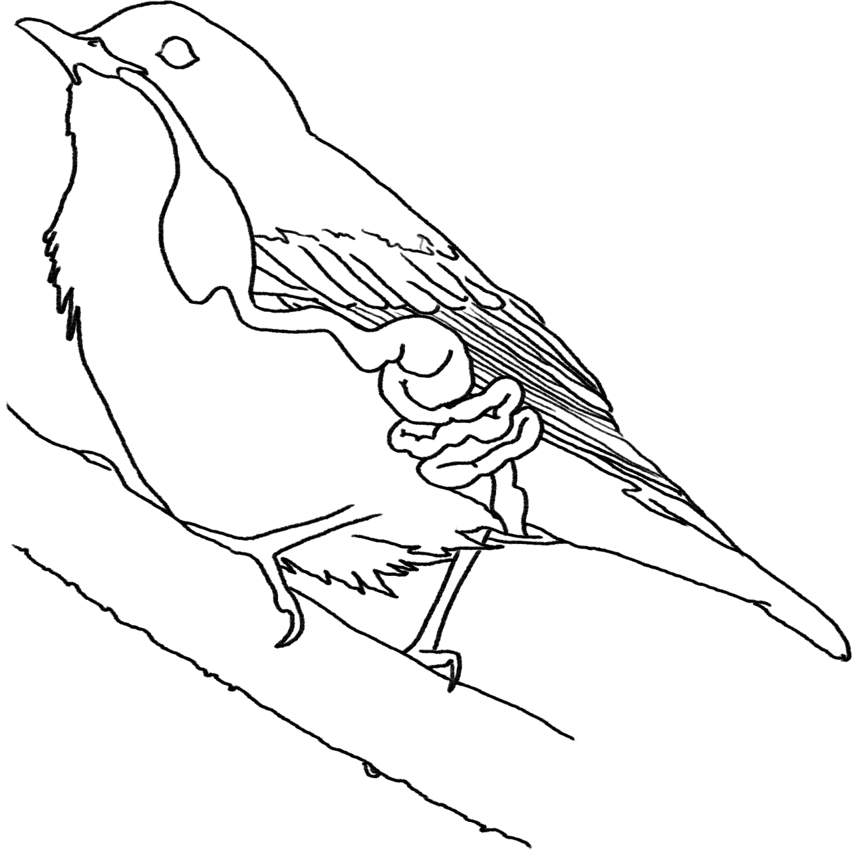
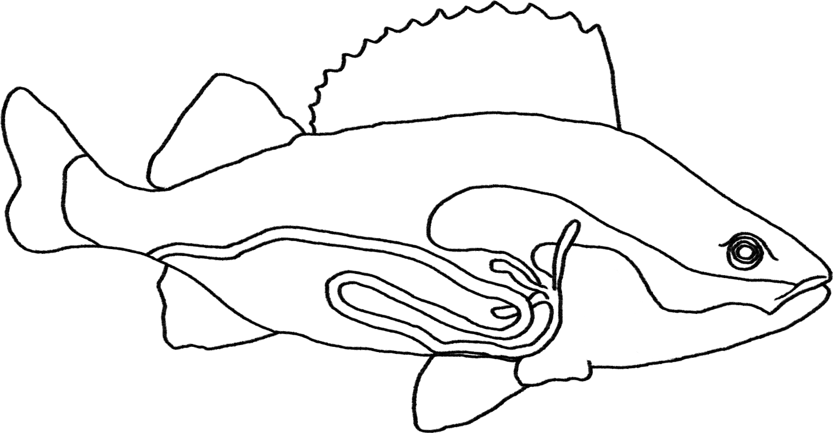
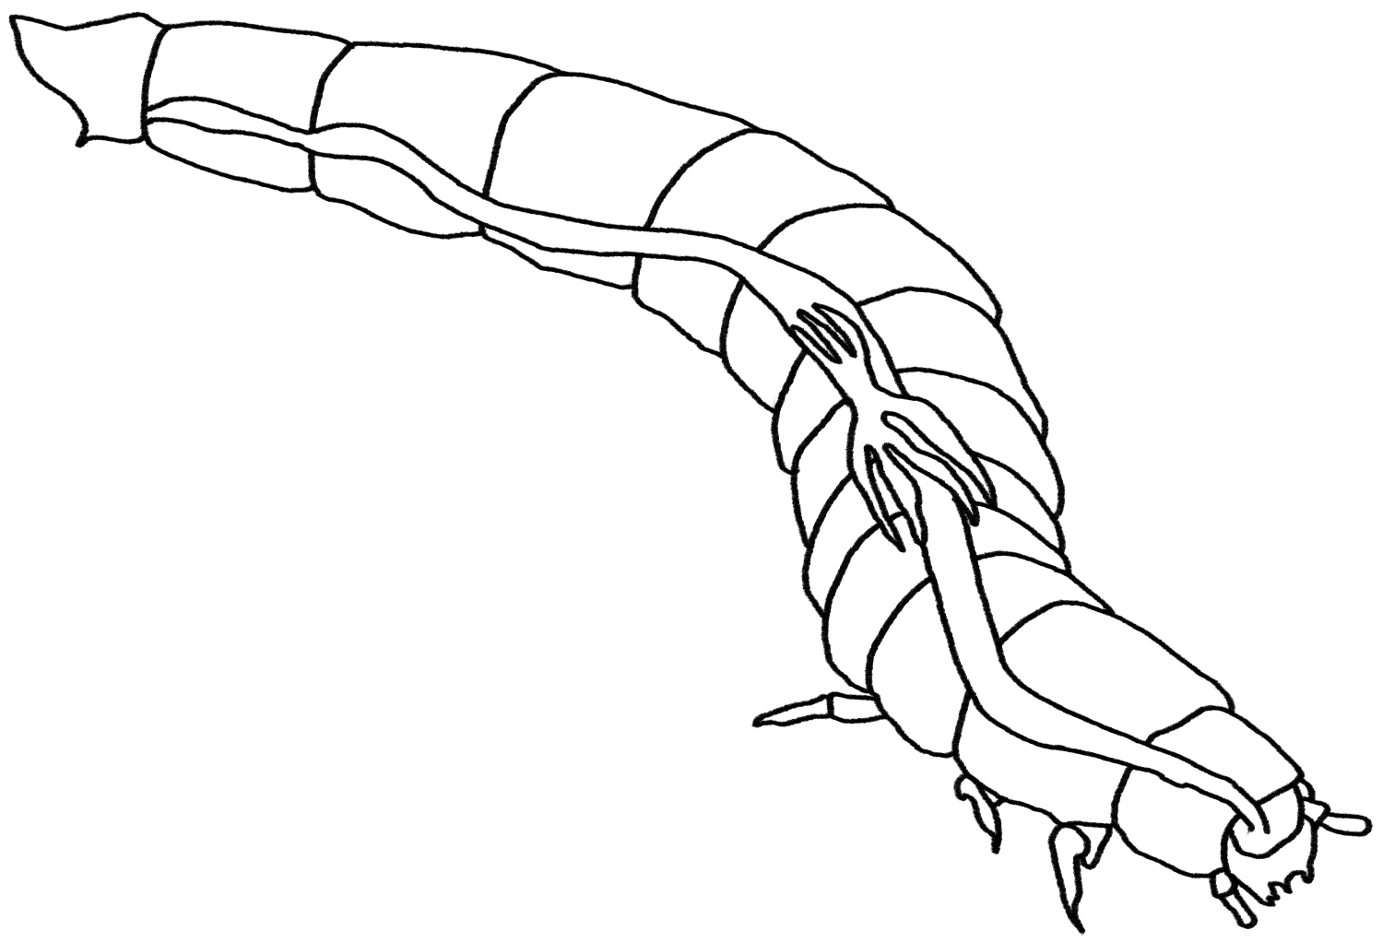
Explaining Movement, Growth, and Functioning in Other Animals
Notes:
Image Credit: Craig Douglas, Michigan State University
Review the ways in which animals use food.
Use Slides 3-6 of the PPT to review what students have learned about how animals use food.
Slide 3 reminds students that the unit is about all kinds of animals.
Slide 4 reminds students of structures that all animals have in common at different scales: cells that are made of molecules that are made of atoms.
Slide 5 reminds students that all animals eat food made mostly of water and large organic molecules, and that some large organic molecules leave the animals as feces.
Slide 6 reminds students that after food is digested the molecules can either be used for growth through biosynthesis or energy through cellular respiration.
Tell students that their explanations today will be to tell this whole story.

Slide 4


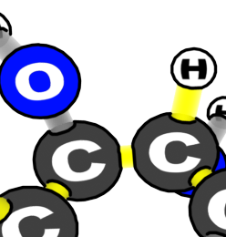
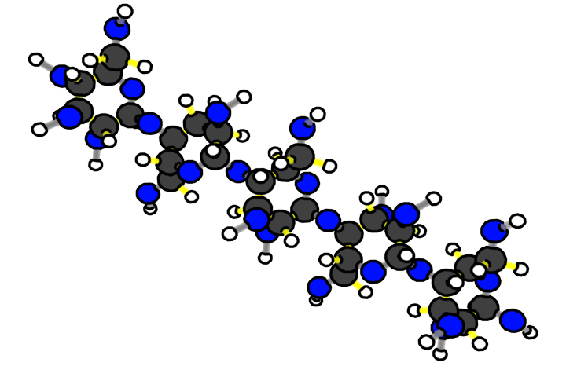
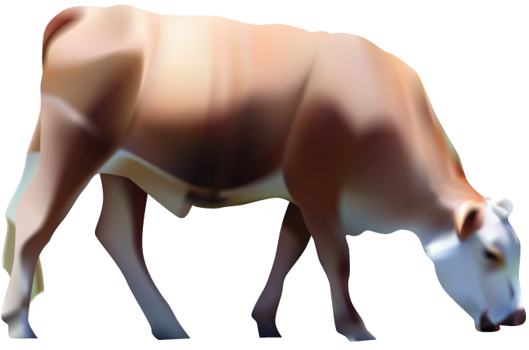
Animals are made of cells
Animal molecules are made of atoms
Animal cells are made of molecules
Benchmark Scale | Power of Ten | Decimal Style
Large scale | Larger 10⁵ 10⁴ 10³ | Larger 100,000 10,000 1,000
Macroscopic | 10² 10¹ 10⁰ 10⁻¹ 10⁻² 10⁻³ | 100 10 1 meter 0.1 0.01 0.001
Microscopic | 10⁻⁴ 10⁻⁵ 10⁻⁶ 10⁻⁷ | 0.0 001 0.00 001 0.000 001 0.0 000 001
Atomic-molecular | 10⁻⁸ 10⁻⁹ Smaller | 0.00 000 001 0.000 000 001 Smaller
Scale: 10⁻⁸ meters = 0.00 000 001 meters
Scale: 10⁻⁹ meters = 0.000 000 001 meters
Scale: 10⁻⁶ meters = 0.000 001 meters
Scale: 10⁻⁷ meters = 0.0 000 001 meters
Scale: 10⁻⁵ meters = 0.00 001 meters
Scale: 10⁻⁴ meters = 0.0 001 meters
Scale: 10⁻³ meters = 0.001 meters
Scale: 10⁻² meters = 0.01 meters
Scale: 10⁰ meters = 1 meters
Scale: 10⁻¹ meters = 0.1 meters
Notes:
Image Credit: Craig Douglas, Michigan State University
Review the ways in which animals use food.
Use Slides 3-6 of the PPT to review what students have learned about how animals use food.
Slide 3 reminds students that the unit is about all kinds of animals.
Slide 4 reminds students of structures that all animals have in common at different scales: cells that are made of molecules that are made of atoms.
Slide 5 reminds students that all animals eat food made mostly of water and large organic molecules, and that some large organic molecules leave the animals as feces.
Slide 6 reminds students that after food is digested the molecules can either be used for growth through biosynthesis or energy through cellular respiration.
Tell students that their explanations today will be to tell this whole story.

Slide 5
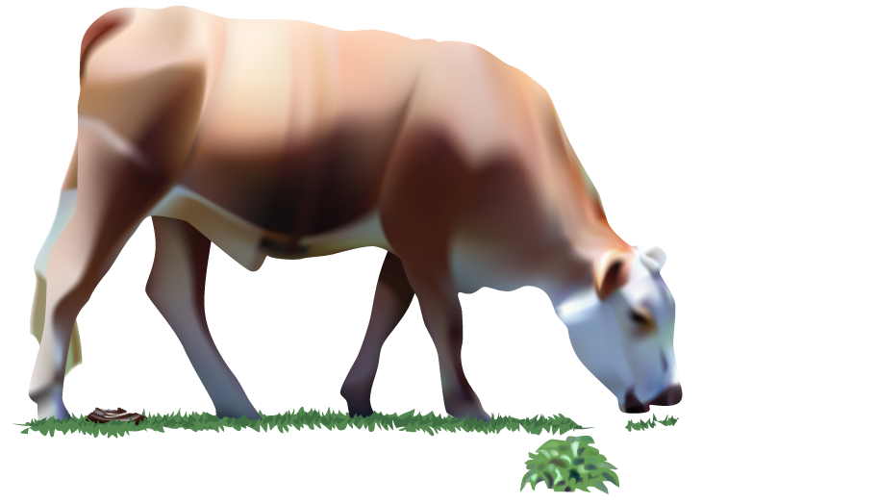
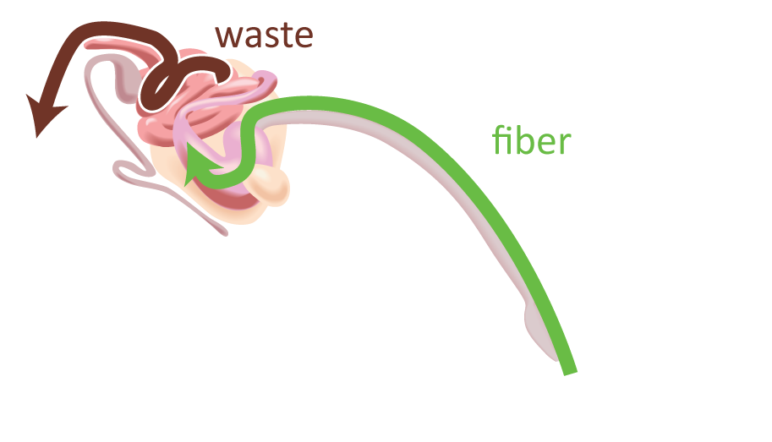

Animals don’t digest all the food that they eat
Our digestive systems cannot break down some large organic molecules (such as fiber).
These molecules leave our bodies as feces.
Notes:
Image Credit: Craig Douglas, Michigan State University
Review the ways in which animals use food.
Use Slides 3-6 of the PPT to review what students have learned about how animals use food.
Slide 3 reminds students that the unit is about all kinds of animals.
Slide 4 reminds students of structures that all animals have in common at different scales: cells that are made of molecules that are made of atoms.
Slide 5 reminds students that all animals eat food made mostly of water and large organic molecules, and that some large organic molecules leave the animals as feces.
Slide 6 reminds students that after food is digested the molecules can either be used for growth through biosynthesis or energy through cellular respiration.
Tell students that their explanations today will be to tell this whole story.

Slide 6
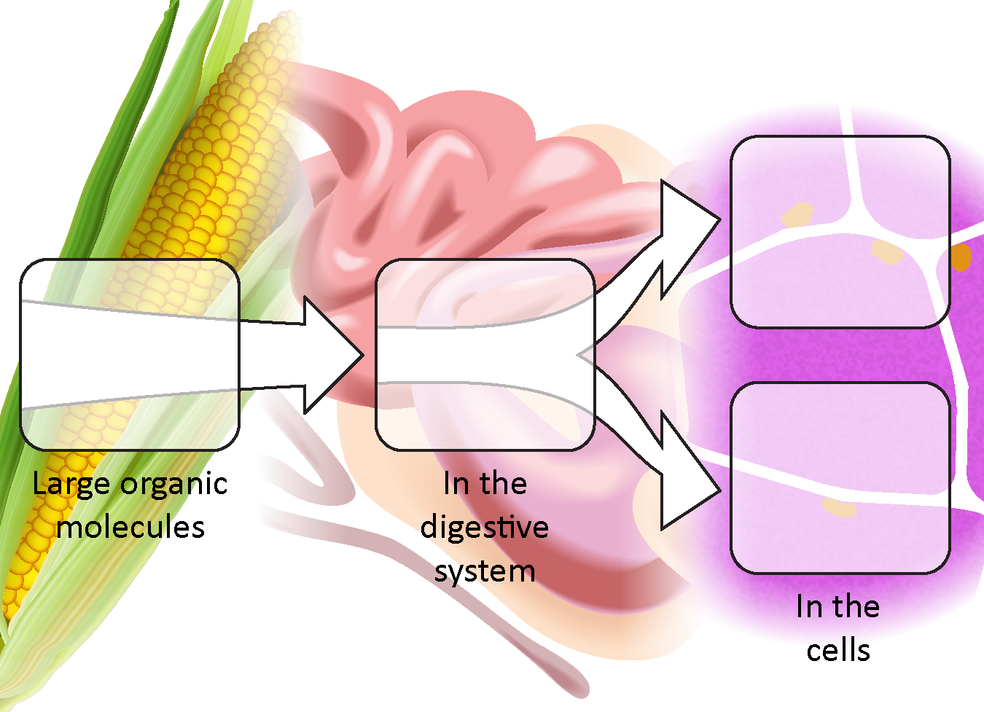
Animal cells use digested food in two ways
Materials
for growth:
Biosynthesis
Food
Digestion
Energy:
Cellular
respiration
Notes:
Image Credit: Craig Douglas, Michigan State University
Review the ways in which animals use food.
Use Slides 3-6 of the PPT to review what students have learned about how animals use food.
Slide 3 reminds students that the unit is about all kinds of animals.
Slide 4 reminds students of structures that all animals have in common at different scales: cells that are made of molecules that are made of atoms.
Slide 5 reminds students that all animals eat food made mostly of water and large organic molecules, and that some large organic molecules leave the animals as feces.
Slide 6 reminds students that after food is digested the molecules can either be used for growth through biosynthesis or energy through cellular respiration.
Tell students that their explanations today will be to tell this whole story.

Slide 7
Explaining a Different Animal
You will now explain how a different animal uses food to grow, move and function. Here are the animals:
A bird
A mealworm
A fish
A dog
A boy
Notes:
Assign students an animal to explain.
Display slide 7 of the PPT. Allow each student to choose which animal they would like to explain or assign students each an animal. The choices are human child, dog, bird, fish, and mealworm. Each student will be writing an explanation about how one of these animals grows, moves, and function.
Give students the version of 6.1 Explaining Other Examples of Animals Growing, Moving, and Functioning for the animal they will be explaining.

Slide 8
Drawing and Labeling Arrows
All animals use digestion, cellular respiration, and biosynthesis to grow, move, and function.
Drawing and labeling arrows:
Draw lines from the cell pictures to the animal’s picture to show the location of each cell in the animal’s body.
Draw arrows to show how carbon-containing molecules move through the animal’s body for each cell to perform its process.
Draw arrows into, through, or out of the dark-bordered cells to show how molecules move for the cell’s process.
Label the arrows with the kind of molecule (large organic, small organic, CO₂).
Notes:
Have students draw the three processes, digestion, cellular respiration, and biosynthesis.
Display slide 8. Have students complete the first page of their 6.1 Explaining Other Examples of Animals Growing, Moving, and Functioning by drawing arrows and adding labels to show digestion, cellular respiration, and biosynthesis.
Students should follow the four numbered steps at the top of the page.

Slide 9
Comparing Ideas with a Partner
Compare your arrows and labels with someone who has the same animal
  How are they alike?
  How are they different?
Consider making revisions to your arrows and labels based on your conversation with your partner.
Notes:
Have students compare their drawings with a partner and revise their drawings.
Divide students into pairs that are working on explanations for the same animal.
Show Slide 9. Have students compare their drawings.
(Optional) Show Slide 10, using the animation to show one step at a time. Have students check their own arrows and labels or their partner’s.
Students can make revisions using a different colored writing utensil.

Slide 10
Check Yourself or Your Partner
Check to see if you have drawn or labeled these arrows:
On the whole animal:
  Large organic molecules going through the digestive system
  Small organic molecules going from the intestine to the skin and muscle cells
Small organic molecules going through the intestine cell to the blood
Small organic molecules going into the skin cells for biosynthesis
For cellular respiration in the muscle cells:
  Small organic molecules (and O₂) going in
  CO₂ (and H₂O) going out
Notes:
Have students compare their drawings with a partner and revise their drawings.
Divide students into pairs that are working on explanations for the same animal.
Show Slide 9. Have students compare their drawings.
(Optional) Show Slide 10, using the animation to show one step at a time. Have students check their own arrows and labels or their partner’s.
Students can make revisions using a different colored writing utensil.

Slide 11
Explaining the Cellular Processes
Use the boxes on the second page to explain each of the three cellular processes that the animal uses to grow, move, and function.
For each explanation:
  Be sure to answer the four numbered questions on your Three Questions handout
  Be sure that your explanations follow the conservation rules for matter and energy
Notes:
Have students write their explanations.
Display slide 11. Explain that students can use the modified versions of the Three Questions on the slide and the Three Question 11 x 17 Poster (or Handout) to guide their explanations.
Display slide 12 and explain that because there are three processes that animals use to grow, move, and function, the Three Questions will need to be answered for each process in their explanations.
Students will write their explanations in the boxes on the second page of their 6.1 Explaining Other Examples of Animals Growing, Moving, and Functioning.
Encourage students to connect their digestion explanation to their explanations for cellular respiration and biosynthesis by making a connection between the products of digestion and the reactants of the other two processes.
Each explanation should address all of the Three Questions.

Slide 12














Answer each of the questions (numbered 1-4) below to explain how matter and energy move and change in a system. Note that matter movement is addressed at both the beginning (1) and end (4) of your explanation.
Question
Where are molecules moving?
How do molecules move to the location of the chemical change?
How do molecules move away from the location of the chemical change?
Evidence We
Can Observe
Moving solids, liquids, and gases are made of moving molecules.
A change in mass shows that molecules are moving.
Rules to Follow
All materials (solids, liquids, and gases) are made of atoms that are bonded together in molecules.
Scale: The matter movement question can be answered at the atomic-molecular, cellular, or macroscopic scale.
Question
How are atoms in molecules being rearranged into
different molecules?
What molecules are carbon atoms in before and after the chemical change?
What other molecules are involved?
Evidence We
Can Observe
BTB can indicate CO₂ in the air.
Organic materials are made up of molecules containing carbon atoms:
• fuels • foods
• living and dead plants and
animals
decomposers
Rules to Follow
Atoms last forever in combustion and living systems.
Atoms can be rearranged to make new molecules, but not created or destroyed.
Carbon atoms are bound to other atoms in molecules.
Scale: The matter change question is always answered at the atomic-molecular scale.
Question
What is happening
to energy?
What forms of energy are involved?
What energy transformations take place during the chemical change?
Evidence We
Can Observe
We can observe indicators of different forms of energy before and after chemical changes:
• light energy • heat energy
• chemical energy stored in organic materials
• motion energy
Rules to Follow
Energy lasts forever in combustion and living systems.
Energy can be transformed, but not created or destroyed.
C-C and C-H bonds have more stored chemical energy than C-O and H-O bonds.
Scale: The energy change question can be answered at the atomic-molecular, cellular, or macroscopic scales.
Notes:
Have students write their explanations.
Display slide 11. Explain that students can use the modified versions of the Three Questions on the slide and the Three Question 11 x 17 Poster (or Handout) to guide their explanations.
Display slide 12 and explain that because there are three processes that animals use to grow, move, and function, the Three Questions will need to be answered for each process in their explanations.
Students will write their explanations in the boxes on the second page of their 6.1 Explaining Other Examples of Animals Growing, Moving, and Functioning.
Encourage students to connect their digestion explanation to their explanations for cellular respiration and biosynthesis by making a connection between the products of digestion and the reactants of the other two processes.
Each explanation should address all of the Three Questions.

Slide 13
Comparing Ideas with a Partner
Compare your explanations for each of the Three Processes with someone who has the same animal
  How are they alike?
  How are they different?
Check your explanation with the middle- and right-hand columns of the Three Questions handout.
Consider making revisions to your explanations based on your conversation with your partner.
Notes:
Have students compare their explanations with partners and revise their explanations.
Use Slides 13 and 14 to have students compare their explanations with a partner who wrote explanations for the same animal.
Show Slide 13. Have students compare their drawings.
(Optional) Show Slide 14, using the animation to show one step at a time. Have students check their own explanations or their partner’s.
Partners should compare their explanations and make revisions as necessary in a different color.
Have students use the Three Questions 11 x 17 Poster (or Handout) as a reference. Have students check their explanations with the middle and right-hand columns of the poster to make sure they are following the “rules.”

Slide 14
Check Yourself or Your Partner
Check to see if you answered the numbered questions for each process:
Digestion
Matter movement: What organic molecules move through the digestive system? Where does the chemical change of digestion happen?
Matter change: How are the molecules that enter into the digestive system being changed into other molecules?
Energy change: What happens to energy?
Matter movement: How do molecules leave the digestive system (in two ways)?
Cellular respiration:
Matter movement: What molecules move from the blood into the cell?
Matter change: How are the molecules that enter the cell changed into different molecules?
Energy change: What happens to energy?
Matter movement: How do product molecules leave the cell?
Biosynthesis:
Matter movement: What molecules move from the blood into the cell?
Matter change: How are molecules that enter the cell rearranged into different molecules?
Energy change: What happens to energy?
Matter movement: What happens to the product molecules inside the cell?
Notes:
Have students compare their explanations with partners and revise their explanations.
Use Slides 13 and 14 to have students compare their explanations with a partner who wrote explanations for the same animal.
Show Slide 13. Have students compare their drawings.
(Optional) Show Slide 14, using the animation to show one step at a time. Have students check their own explanations or their partner’s.
Partners should compare their explanations and make revisions as necessary in a different color.
Have students use the Three Questions 11 x 17 Poster (or Handout) as a reference. Have students check their explanations with the middle and right-hand columns of the poster to make sure they are following the “rules.”

Slide 15
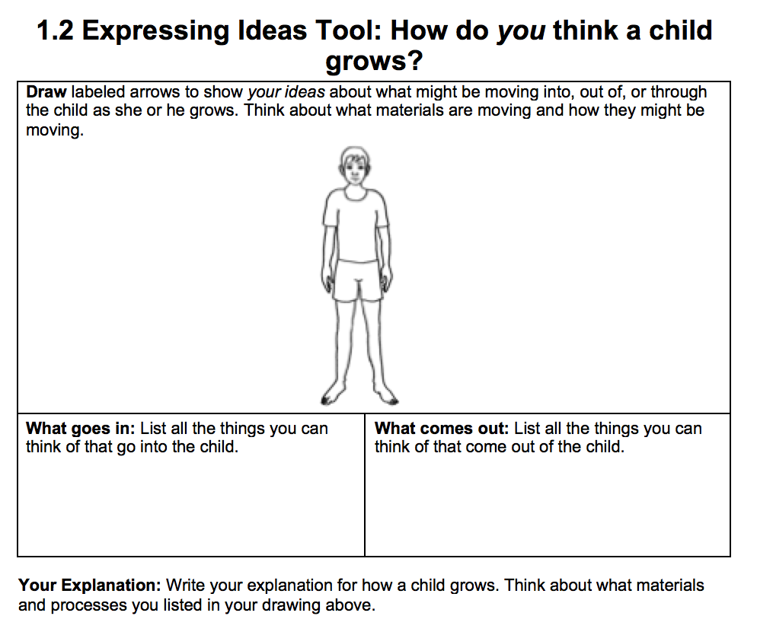
Revisit Your Initial Ideas
Look back at your initial ideas about how a child grows from Lesson 1.2.
What were your initial ideas?
How have your ideas changed?
What questions did you have?
Notes:
Have students revisit their initial ideas from Lesson 1.
Display slide 15. Have students look back at their initial ideas on 1.2 Expressing Ideas Tool about Animals Growing.
Ask them to share some of their initial ideas, their thinking about how their ideas have changed, and what their initial questions were.
Ask them how they would now answer their initial questions.

Slide 16
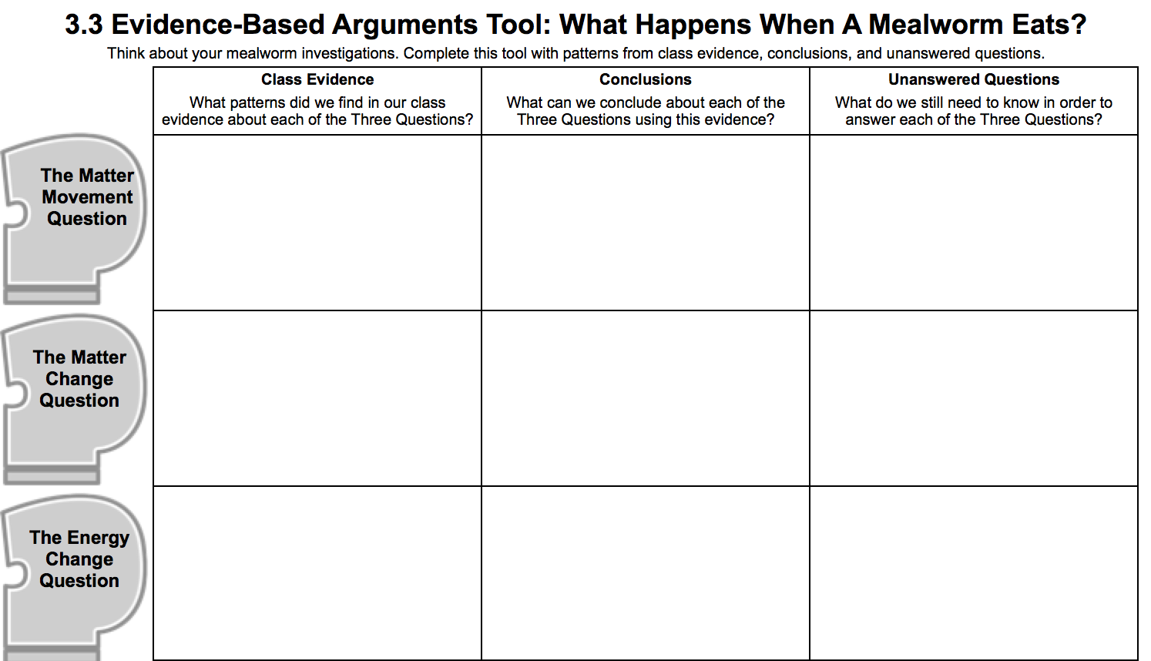
Revisit the Mealworm Investigation
Look back at the Mealworm Investigation Results and your Evidence-Based Arguments.
What was the overall change in mass for the whole system?
What caused the change in mass?
How do mealworms grow, move, and function?
Notes:
Have students revisit their data and unanswered questions from the Mealworms Eating Investigation from Lesson 3.
Have students review their data from 3.2 Mealworms Eating Class Results 11 x 17 Poster (or Spreadsheet).
Have students review their evidence-based arguments and unanswered questions from their 3.3 Evidence-Based Arguments Tool for Mealworms Eating.
Have them consider how they would now answer their unanswered questions.

